Slide 1
MLOps
.. en containers

Slide 2
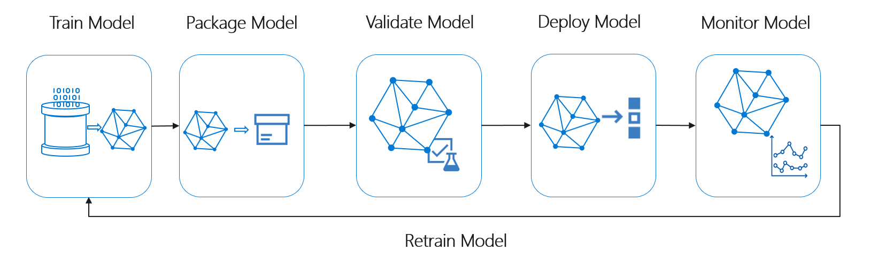
MLOps globaal

Slide 3
Key Challenges – why MLOps?
Model reproducibility & versioning
Track, snapshot & manage assets used to create the model
Enable collaboration and sharing of ML pipelines
Model auditability & explainability
Maintain asset integrity & persist access control logs
Certify model behavior meets regulatory & adversarial standards
Model packaging & validation
Support model portability across a variety of platforms
Certify model performance meets functional and latency requirements
Model deployment & monitoring
Release models with confidence
Monitor & know when to retrain by analyzing signals such as data drift

Slide 4













Machine Learning Operationalization (ML Ops)
Based on DevOps principles, including:
Infrastructure-as-code and configuration management
Version control and tracking
Continuous integration and delivery (CI/CD)
Continuous monitoring
Experiment history, including metrics, outputs, and metadata
On-demand compute with reusable environments
Dataset and model versioning
Pipelines, event-driven automation, and CI/CD
Monitoring of deployed models and data drift
Notes:
Increasingly, enterprises are seeking to integrate machine learning model training, deployment, and management into existing processes for developing and delivering software. What's become known as "Machine Learning Operationalization", or "ML Ops" has become part of the larger move towards "Development/Operations" or "DevOps".
DevOps is a combination of best practices for team collaboration and operational automation that helps drive efficiency in creating, deploying, and managing software solutions at enterprise scale. Often, data scientists and machine learning specialists work in relative isolation from the software developers who integrate their models into applications and the system administrators who manage the deployed application infrastructure, but by adopting some DevOps principles, these disparate teams can coordinate activities to create an effective overall solution.
Azure Machine Learning provides multiple capabilities that an organization can leverage for ML Ops, and integrates with more general DevOps tools such as Azure DevOps and GitHub. The slide shows some of the key ways in which Azure Machine Learning supports ML Ops; and you'll explore these capabilities in more depth in the remainder of this course.

Slide 5
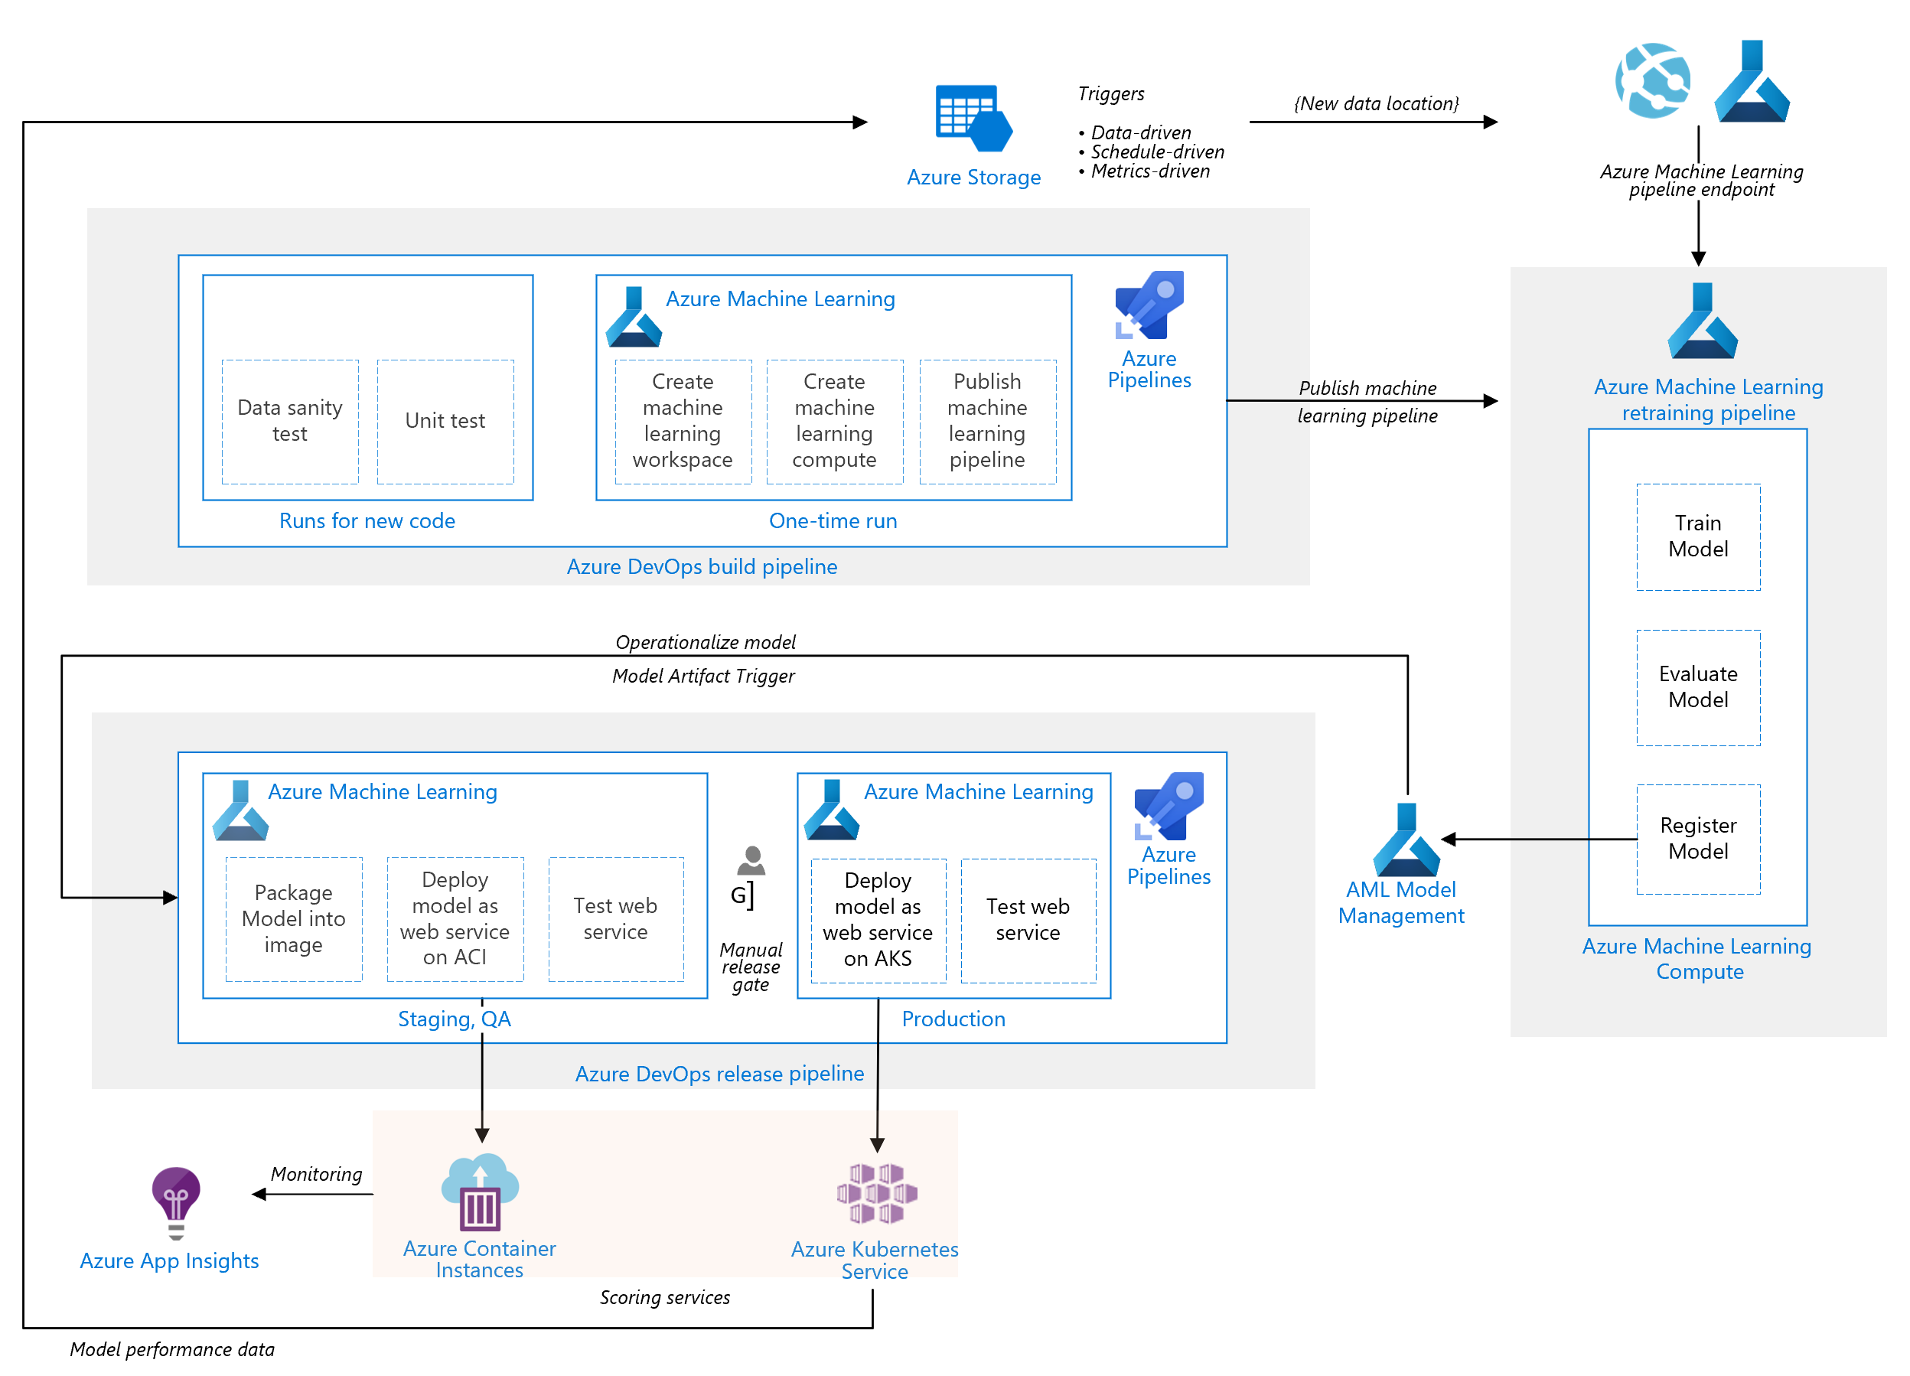
Build:
Verwerk de Python/R-code tot een package
Retraining:
Laat de package een model trainen.
Release:
Operationaliseer het model. Rol het uit over verschillende omgevingen.
Notes:
This solution is based on the following three pipelines:
Build pipeline. Builds the code and runs a suite of tests.
Retraining pipeline. Retrains the model on a schedule or when new data becomes available.
Release pipeline. Operationalizes the scoring image and promotes it safely across different environments.

Slide 6
Notes:
This solution is based on the following three pipelines:
Build pipeline. Builds the code and runs a suite of tests.
Retraining pipeline. Retrains the model on a schedule or when new data becomes available.
Release pipeline. Operationalizes the scoring image and promotes it safely across different environments.

